Slide 1
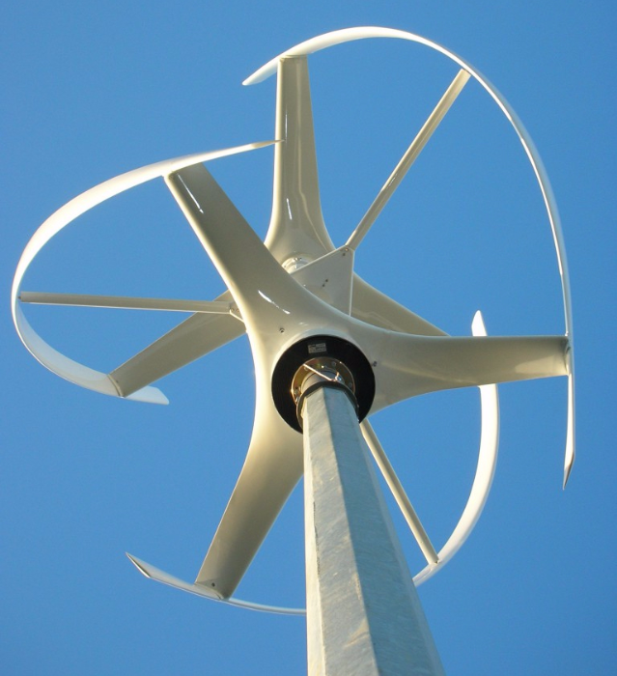

VERTICAL WIND TURBINE Gorlov
Alexandria University,
Faculty of Engineering,
Mechanical Engineering Department
SUPERVISED BY:
Dr. ESLAM REDA LOTFY
Addressed To:
( )
( ) COMPANY. (Address)

Slide 2
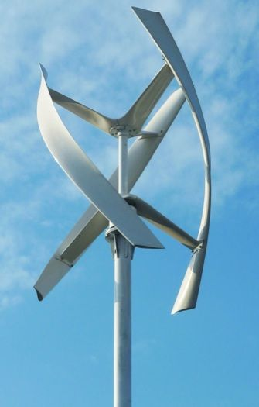
STATUS QUO
Contents
Introduction …………………………………………………………..2
Egypt’s Consumption of Electricity…………………..3
Wind Energy and Solar Energy………………………..4
Wind Turbine Types…………………………………….….5
Gorlov Wind Turbine………………………………………5
Project Objectives………………………….……………………….6
Project Procedure……………………………………………………7
Project Schedule……………………………………………………..8
Fee Summary………………………………………………………….9
Team Members………………………………….………………….10
Proposal Sign off……………………………………………………11

Slide 3
STATUS QUO
Introduction
Egypt is a net exporter of crude oil and natural gas, however, the combination of increasing consumption and declining production has led to a decline in natural gas exports since 2009, as the government started to divert natural gas supplies from exports, in order to satisfy domestic demand, eventually turning the country into a natural gas importer since 2015
Egypt’s Production of Different Energy Sources during the 2000s in Ktoe
 | 2000 | 2005 | 2012 | 2013 | 2014 | 2015 | 2016 | 2017
Coal | 20 | 14 | 0 | 0 | 0 | 0 | 0 | 0
Crude Oil | 33189 | 30111 | 32142 | 29537 | 32825 | 33210 | 30835 | 31885
Natural gas | 18555 | 35901 | 54839 | 50143 | 39084 | 34763 | 34763 | 35362
Electricity from Fossil Fuels | 5302 | 8211 | 12250 | 12250 | 13431 | 14355 | 14514 | 14679
Hydro Electricity | 1260 | 1087 | 1112 | 1113 | 1188 | 1155 | 1171 | 1187
Electricity from Renewables | 12 | 47 | 139 | 139 | 145 | 137 | 150 | 165
Refinery/Oil Products | 23449 | 28561 | 24754 | 21836 | 25348 | 25676 | 26357 | 270565
Electricity Access
According to the U.S. Central Intelligence Agency (CIA)'s 2018 report, only around 300,000 people of the whole Egyptian population is currently without access to electricity.

Slide 4
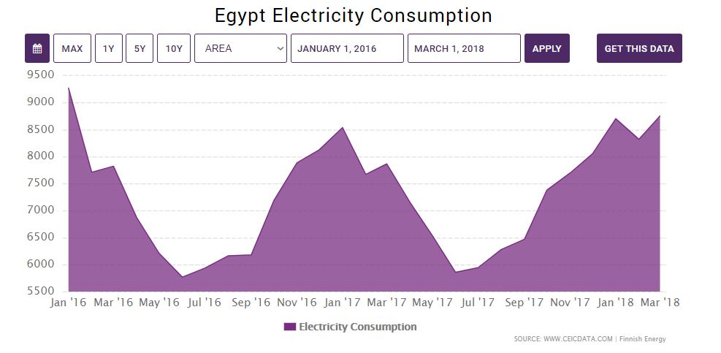
Click to add content...
STATUS QUO
Introduction
Egypt’s Electricity Consumption data was reported at 12,277.000 kWh in Mar 2018. This records an increase from the previous number of 11,612.000 kWh for Feb 2018. Egypt’s Electricity Consumption data is updated monthly, averaging 8,565.000 kWh from Jan 1997 to Mar 2018, with 255 observations. The data reached an all-time high of 39,385.000 kWh in Sep 2012 and a record low of 3,737.230 kWh in Feb 1997. Egypt’s Electricity Consumption data remains active status in CEIC and is reported by Ministry of Electricity and Energy. The data is categorized under Global Database’s Egypt.
The cost of energy from municipal power grids keeps going up, and the importance of maintaining a healthy environment grows every day. Egypt intends to supply 20 percent of generated electricity from renewable sources by 2022, with wind providing 12 percent, Hydro power 5.8 percent, and Solar 2.2 percent. On the other hand, construction organizations and people in general seek efficient ways of providing energy and there is major concern for engineering companies around world of Utilizing the Renewable Energy with small scale making it suitable for buildings roofs, gardens and other properties.

Slide 5
Click to add content...
Introduction
Wind Energy Vs Solar Energy
 | WIND TURBINES | SOLAR PANELS
Driving Source | Wind energy, works all day | Sunlight, works during daylight only
Surface Area (For 5KW Power Production) | As (Circle) =0.7 m² | As (Rectangle) = 55 m²
Environmental Effect | Neither have toxic materials nor producing pollutants | Large amount of fossil fuels & toxic materials like the PVC & glues are used in the manufacture of the cells and the waste cause disposal problems
Overall Net Benefits
 | Wind | Solar
Avoided Emissions | $284,526 | $185,338
Avoided Energy Cost | $98,925 | $67,732
Avoided Capacity Cost | $70,482 | $46,425
Fixed Cost Incurred | $-162,687 | $-181,434
Other Costs (Periodic O&M) | $-7,755 | $-4,713
Total Net Benefits /MW/Year | $283,311 | $113,349

Slide 6
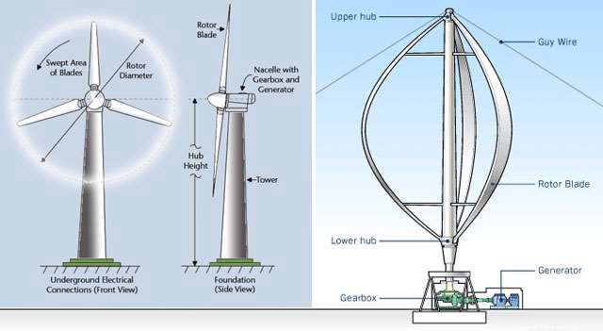
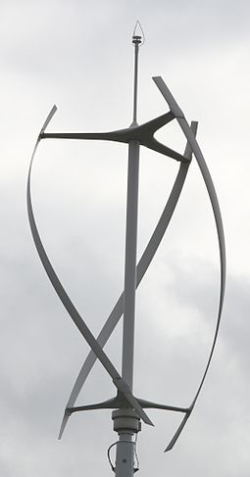
Click to add content...
AZZZZ
STATUS QUO
Introduction
Vertical Vs Horizontal WT
A wind turbine generator can have a vertical or horizontal rotation axis. A vertical-axis wind turbine is advantageous for installation in city centers because it is not affected by the direction of the wind as much as a horizontal-axis wind power generator.
It is easy to maintain because it does not need complicated structure such as yawing devices.
Gorlov Wind Turbine
Our prototype design is a Darrieus turbine with its blades canted into a helix, this type is called Gorlov. With our prototype and since the wind pulls each blade around on both the windward and leeward sides of the turbine, this feature spreads the torque evenly over the entire revolution, thus preventing destructive pulsations.

Slide 7
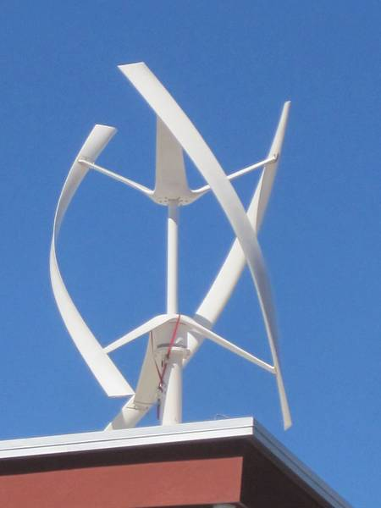
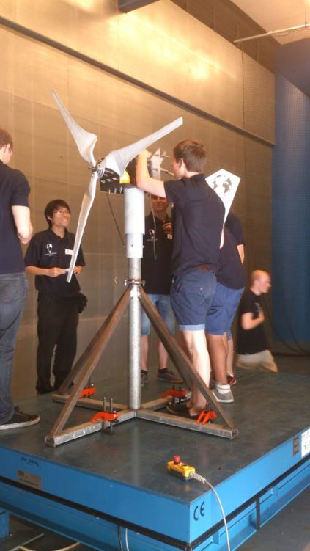
PROJECT Objectives
Our goal is to optimize a small scale wind turbine based on the range of power that would run all day on wind energy available. Achieving the optimum design to reach the maximum use of wind, our design is according to Gorlov type which produces a higher lift force than the drag force which is highly required to ensure the continuity of blade rotation. This design also overcomes that challenge of changing the angle of attack and the change of momentum decreasing stresses generated on the blades. The length of our design is about 1.3 meters. Our Prototype can be installed on a rooftop of a house where wind is conveniently continuous to generate necessary power to feed the house’s appliances.
With our prototype we’ll be participating in the International Wind Turbine Design Contest IWTC organized by Hanze University of Applied Sciences in the Netherlands and hopefully win the IWTC 2019.

Slide 8
PROJECT Procedure
Work Flow
 | Process | Description
1 | Determining Range of Power | 500~700 Watts
2 | Design Process | Selection of primary dimensions and set of materials that could be used during manufacturing
3 | Simulation Process | 1. Using The Finite Element Method to run a structural analyses 2. Using Computational Fluid Dynamics (CFD) to analyze aerodynamic forces
4 | Finalizing Dimensions | Selection of Final Dimensions
5 | Final Selection of Materials | Selection of Final Materials
6 | Manufacturing Process | Using 3D printing to achieve the maximum accuracy of blade manufacture
7 | Testing | Test is run in a wind tunnel to calculate the output power

Slide 9
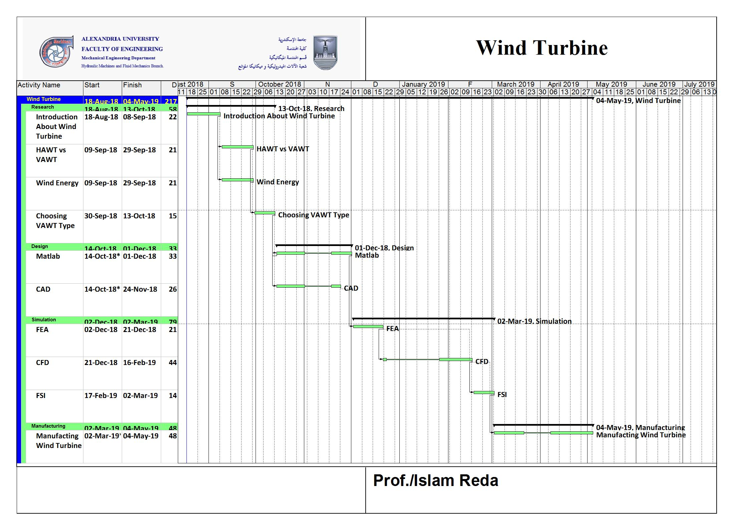
PROJECT SCHEDULE
Project milestones
8

Slide 10
Budget & Cost Analysis

Slide 11

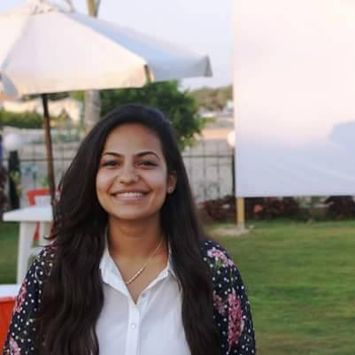





TEAM MEMBERS
Ahmed Essam
Phone: +20 122 0634 810
Email: ahmed.es.ms1@alexu.edu.eg
Mayada ElHussieny
Phone: +20 102 0615 349
Email: mayadaelhoseny1994@gmail.com
Asser Abdelaziz
Phone: +20 106 1256 944
Email: es-asser.abdelaziz1415@alexu.edu.eg
Ali Elsayed
Phone: +20 100 7570 496
Email: alisayed_95@hotmail.com
Tarek Abdallah
Phone: +20 128 2565 435
Email: Tarekabdullah90@yahoo.com
Mayar Zaki
Phone: +20 100 4828 514
Email: mayarmzaki@gmail.com
Omar Youssef
Phone: +20 109 0842 007
Email: morojo24@gmail.com

Slide 12
PROPOSAL SIGN-OFF

SIGN HERE
Dr. ESLAM REDA LOTFY
Alexandria University
The Faculty of Engineering
Mechanical Engineering Department
( ),
Head
Example Company

